Slide 1
XFM Vending Machine
Joseph Olin
Michael Roark
Branden Wagner

Slide 2
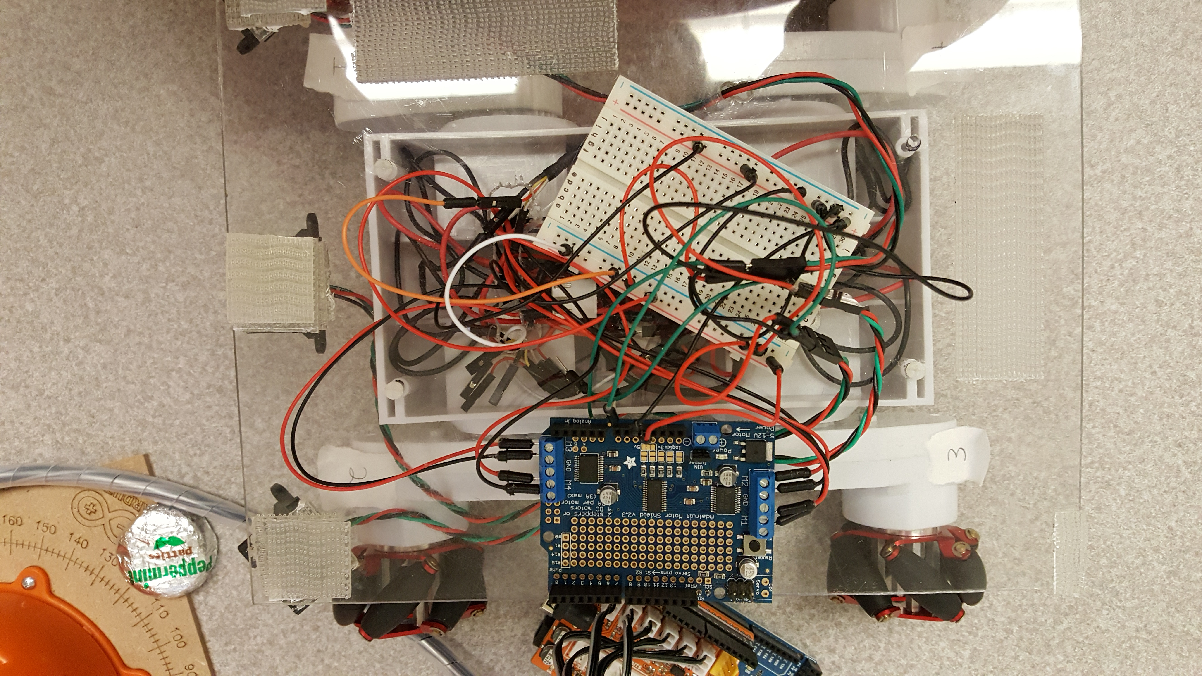
What is XFM Vending Machine?
An Arduino-based robot that delivers mint patties to customers sitting at a counter

Slide 3
Purpose
Demonstrating how a familiar task, such as tending bar, can be handled by a low cost intelligent robot

Slide 4
Methodologies
Implemented the Agile development cycle
A list of tasks and items was created each week
Team meetings held twice a week to discuss and work on the robotic system

Slide 5
Components List
Arduino Braccio Arm
RC-7 Rover chassis
Arduino Adafruit microcontroller
RGB color sensor
Line follower sensor
A bag of mints
12V DC battery power supply
5V DC power supplied from wall
Notes:
This could be a numbered list with for a diagram on another slide.

Slide 6
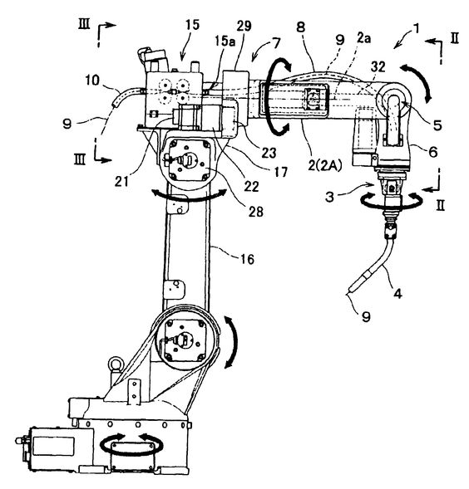
Diagram of the System (example pics)
Notes:
Two examples of diagram picture styles.

Slide 7
Order of Completion
Tested navigation of the robot via the four wheels
Assembled and tested the robotic arm
Prepared and mounted a sturdier platform on top of the chassis
Mounted and tuned the RGB color sensor
Mounted and tuned the line follower sensor
Integrated parts to form the robotic system
Magazine design

Slide 8
Operational Flow
Line follower finds the path
Rover moves forwards, then backwards
RBG sensor detects order and arm activates
Green is for a single mint
Arm moves to grab mints on a predetermined path
Robot Continues on path and reverses at the end of the table

Slide 9
Demo
Video link

Slide 10
Observations
One challenge of amateur robot design is finding reliable sources of integrated circuits and batteries
Using standard libraries Arduino means the code does not have to be complicated
However documentation of some functions is not thorough in English language
IDE could be improved
RGB sensors need carefully controlled environments and algorithms
Custom-made robots are becoming more affordable and easily available

